Slide 1
The Patient Safety Incident Response Framework (PSIRF)

Slide 2
The PSIRF – what is it?
The PSIRF replaces the Serious Incident Framework (SIF) established in 2015…
…and sets out NHS England’s approach to developing systems and processes for responding to patient safety events with the aims of improving patient safety and learning lessons.
This new and innovative approach embeds learning from patient safety events within a wider system of improvement.
It is a cultural and system shift in our thinking, prompting a move away from a reactive and bureaucratic approach to safety to a more proactive approach.

Slide 3
What does PSIRF hope to achieve?

Slide 4
How will we respond – National Priorities
There remain mandatory events where an investigation under the PSIRF is required.
These events are listed below.
Deaths thought more likely than not due to problems in care (which meet the criteria)
Deaths of patients detained under the Mental Health Act (1983) or where the Mental Capacity Act (2005) applies, where there is reason to think that the death may be linked to problems in care
Incidents meeting the Never Events criteria
Mental health-related homicides
Child deaths
Maternity and neonatal incidents meeting Healthcare Safety Investigation Branch (HSSIB) criteria
Deaths of persons with learning disabilities
Safeguarding incidents meeting criteria
Incidents in NHS screening programmes
Deaths in patients custody/prison/probation
Domestic homicide

Slide 5
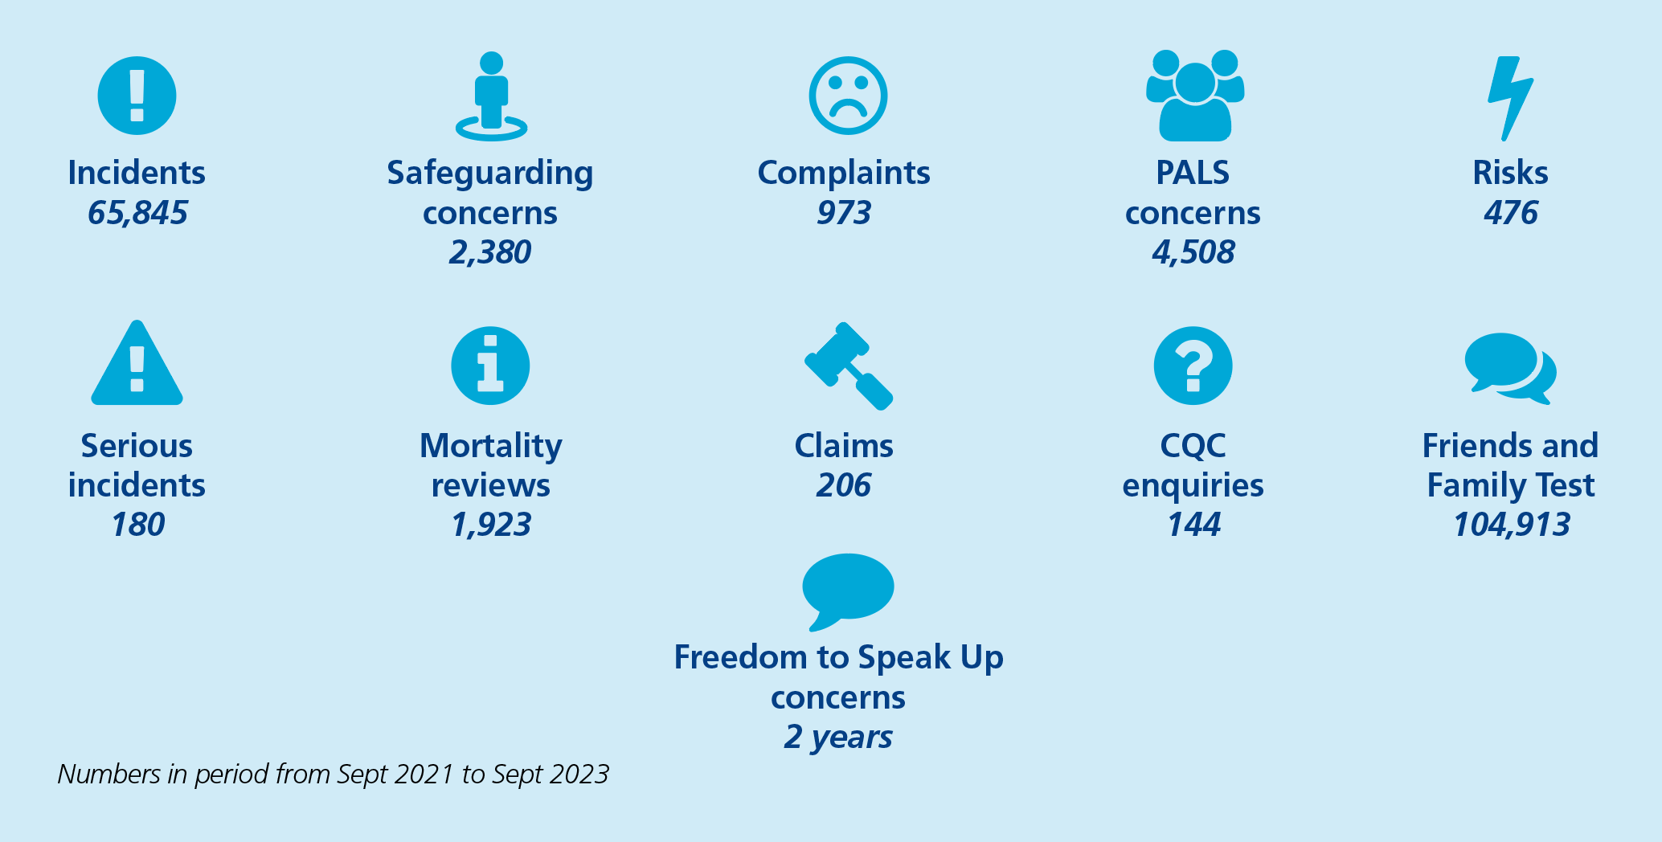
How will we respond – Our Local Priorities
Our local priorities were identified by reviewing our data (see below) and engaging with stakeholders
Delayed recognition of a deteriorating patient, due to gaps in monitoring (including all pregnant women)
Delayed, missed or incorrect cancer diagnosis
Prescribing or administration error or near miss of anticoagulation medication
Adverse Discharge due to gaps in communication or misinformation
Delay in responding to a critical pathology finding

Slide 6
How will we respond – To other patient safety events
Patient safety events that do not meet the national and local priorities criteria will go through a triage process.
This process will determine how the patient safety event will be managed.
This may be through local management, a different type of learning response or a thematic review.

Slide 7
Transition to PSIRF – What is next?
Commences 6th November 2023 subject to policy and PSIRF approval at Board of Directors on 5th October 2023 and ICB Quality Committee on 18th October 2023.
Training is underway in a phased approach following a Training Need Analyses.
Resources assessment has been considered but will undergo ongoing review and assessment as transition continues.
Engagement with a range of stakeholders including patients, families, carers and staff, ICB, CQC and a range of advocacy groups has commenced and will remain ongoing. This is taking into consideration health inequalities and protected groups.
A communication and engagement plan is in place, which includes information leaflets, webpage etc to support our patients, families, carers and staff with their understanding of PSIRF.

Slide 8
Any Questions?
Please email PSIRF@lthtr.nhs.uk
Commences 6th November 2023 subject to policy and PSIRF approval at Board of Directors on 5th October 2023 and ICB Quality Committee on 18th October 2023.
Training is underway in a phased approach following a Training Need Analyses.
Resources assessment has been considered but will undergo ongoing review and assessment as transition continues.
Engagement with a range of stakeholders including patients, families, carers and staff, ICB, CQC and a range of advocacy groups has commenced and will remain ongoing. This is taking into consideration health inequalities and protected groups.
A communication and engagement plan is in place, which includes information leaflets, webpage etc to support our patients, families, carers and staff with their understanding of PSIRF.

